Slide 1

UB Reform in Greece
George Karachalios
Deputy Governor / EL AFEPA
Glykeria Terzi
Head of UI Directorate

Slide 2
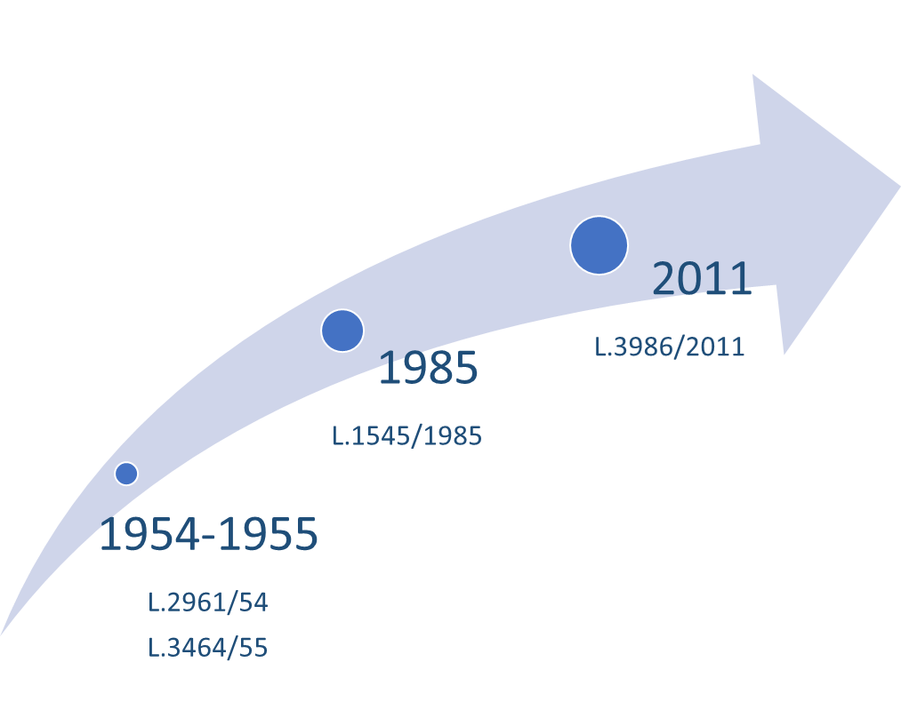

70 years of UB legacy
Unemployment status
Employment contract termination or expiration
The applicants must have accumulated at least 125 working days within the past 14 months prior to termination of the employment relationship, exclusive of the last two months of the said period.
There is a maximum threshold of 400 daily allowances within the past 4 years.
The actual stipend is 25 daily allowances per each full working month and it depends on:
  the number of the previous working days
  the amount of previous wages only for those who get less than minimum wage
  The number of beneficiary’s protected family members
  Christmas/Easter bonuses

Slide 3
LTU Benefit and other allowances
UB beneficiary for 12 months
Means-tested
Lump-sum LTU
12-month period
Special Allowances: 13th-month, 3-month registration, retention

Slide 4
Change for what?
Improve coverage
promote inclusive LM participation
Improve efficiency and effectiveness
Equitable distribution
Strengthen social safety net
Simplification

Slide 5
How?
Reforming UB
(24 month)
Fixed Component
Supplementaries
Variable Component
  150 working days within an 8-month period prior to dismissal
  Average wage of 8-month period ≥ 75% * Minimum Wage
  Available to all beneficiaries
  Intensity of work incentive: At least 1200 insured days within 48 months prior to dismissal
  Employment Record & Previous Earnings
  Christmas/Easter
  Family members
  Single parents

Slide 6

In-Work Benefit
If an UB beneficiary finds a full-time job then he/she can claim the on top of the monthly wage an in-work benefit which is equal to monthly UB*50% for the remaining UB-entitlement period

Slide 7
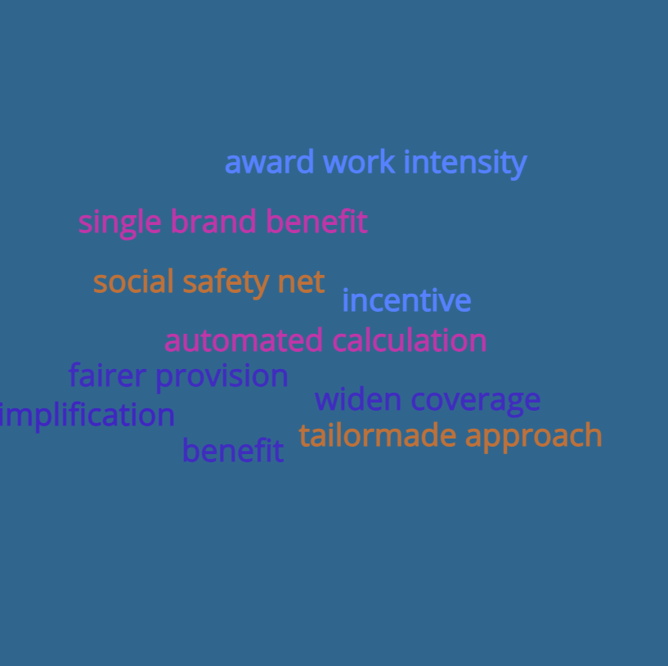
Aim
Automated calculation
Fairer provision
Front-loaded spell
Tailor-made approach
Work intensity
Reduce incentives to UB/LTU
Activate the unemployed
Simplify benefits to one single brand-benefit
Widen coverage

Slide 8

Thank you for your attention

